Slide 1

18CSC203J – COMPUTER ORGANIZATION AND ARCHITECTURE
Course Outcome
CLR-1:Utilize the functional units of a computer
CLO-1 :Identify the computer hardware and how software interacts with computer hardware

Slide 2
Topics Covered
Functional Units of a computer
Operational Concepts
Bus Structures
Memory Location and Addresses
Memory Operations
Instructions and Instruction Sequencing
Addressing modes
Problem Solving
Introduction to Microprocessor
Introduction to Assembly Language
Writing of Assembly Language Programming
ARM Processor: The Thumb instruction set
Processor and CPU CORES
Instruction Encoding Format
Memory load and store instruction in ARM
Basics of IO Operations

Slide 3
Computer Organization and Architecture
Computer Organization deals with the functions and designs of various computer units that process and stores information
Computer Architecture encompasses the specification of instruction set and how the hardware units implements the instructions

Slide 4
Functional Units of a Computer

Slide 5
FUNCTIONAL UNITS OF COMPUTER
Input Unit
Output Unit
Central processing Unit (ALU and Control Units)
Memory
Bus Structure

Slide 6
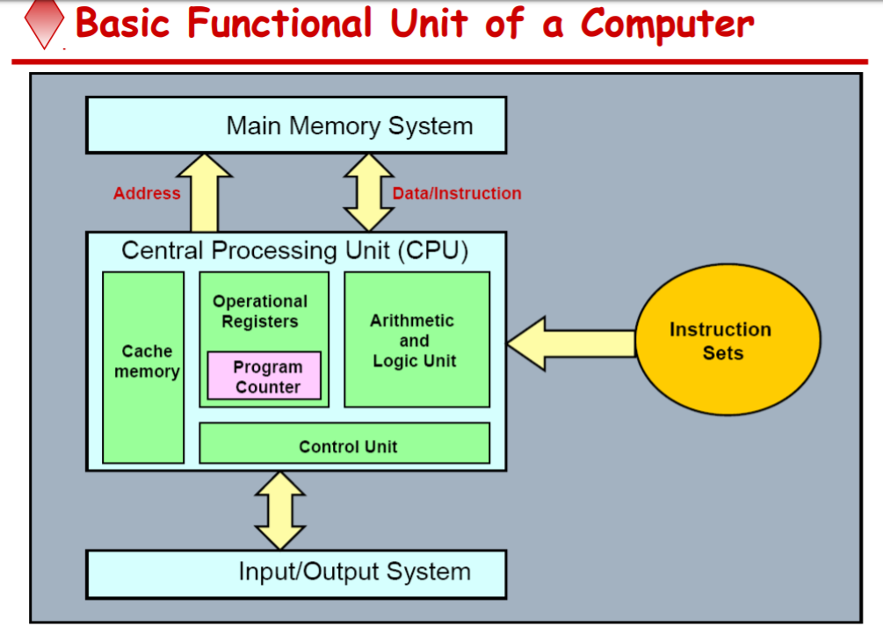

Slide 7
Functions
ALL computer functions are:
Data PROCESSING
Data STORAGE
Data MOVEMENT
CONTROL
Data = Information
Coordinates How Information is Used

Slide 8
Functions of a computer
The operations performed by a computer using the functional units can be summarized as follows:
It accepts information (program and data) through input unit and transfers it to the memory.
Information stored in the memory is fetched, under program control, into an arithmetic and logic unit for processing.
Processed information leaves the computer through an output unit.
The control unit controls all activities taking place inside a computer.

Slide 9
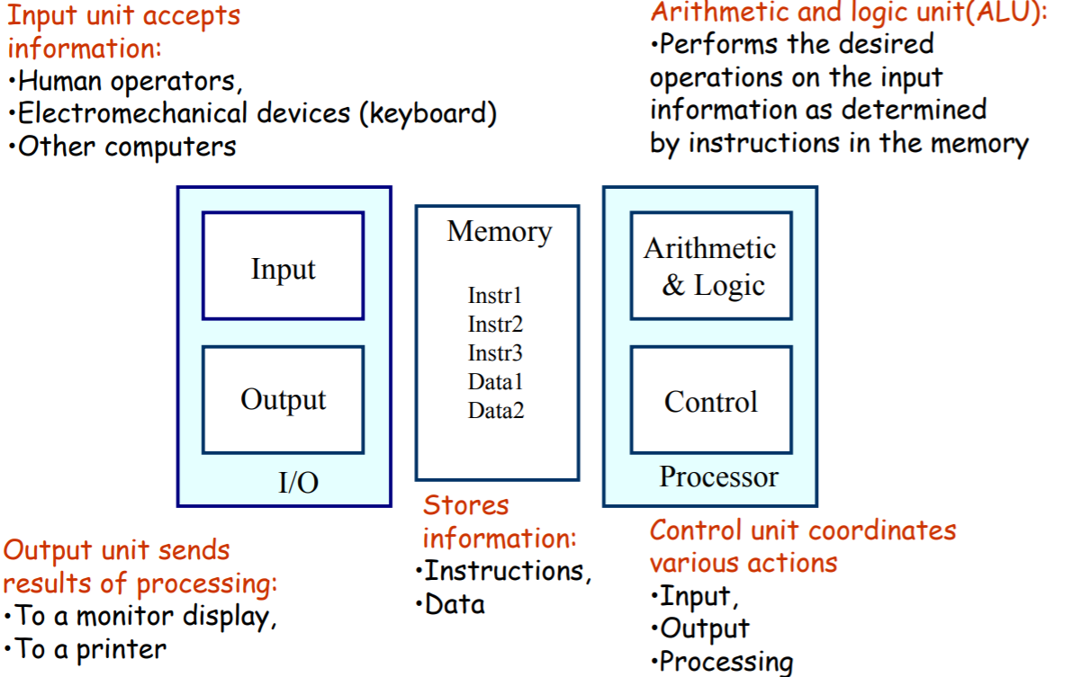

Slide 10
INPUT UNIT:
Converts the external world data to a binary format, which can be understood by CPU
Eg: Keyboard, Mouse, Joystick etc
OUTPUT UNIT:
Converts the binary format data to a format that a common man can understand
Eg: Monitor, Printer, LCD, LED etc

Slide 11
CPU (Central processing Unit)
The “brain” of the machine
Responsible for carrying out computational task
Contains ALU, CU, Registers
ALU Performs Arithmetic and logical operations
CU Provides control signals in accordance with some timings which in turn controls the execution process
Register Stores data and result and speeds up the operation

Slide 12
Example
Add R1, R2
T1
T2
T3
T4
Enable R1
Enable R2
Enable ALU for addition operation
Enable out put of ALU to store result of the operation

Slide 13
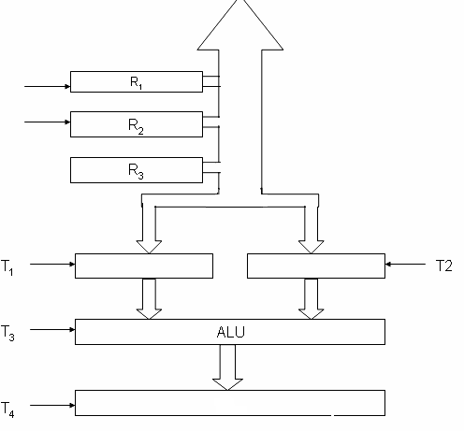
CONTROL UNIT
Control unit works with a reference signal called Processor clock
Processor divides the operations into basic steps
Each basic step is executed in one clock cycle
T1
T2
R1
R2
R2

Slide 14
MEMORY UNIT
Stores data, results, programs
Two class of storage (i) Primary (ii) Secondary
Two types are RAM or R/W memory and ROM read only memory
ROM is used to store data and program which is not going to change.
Secondary storage is used for bulk storage or mass storage

Slide 15
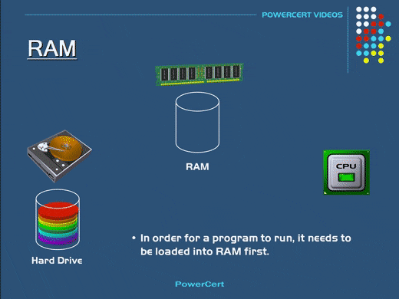

Slide 16
Basic Operational Concepts
Basic Function of Computer
To Execute a given task as per the appropriate program
Program consists of list of instructions stored in memory

Slide 17
A Typical Instruction
Add R0, LOCA
Add the operand at memory location LOCA to the operand in a register R0 in the processor.
Place the sum into register R0.
The original contents of LOCA are preserved.
The original contents of R0 is overwritten.
Instruction is fetched from the memory into the processor – the operand at LOCA is fetched and added to the contents of R0 – the resulting sum is stored in register R0.

Slide 18
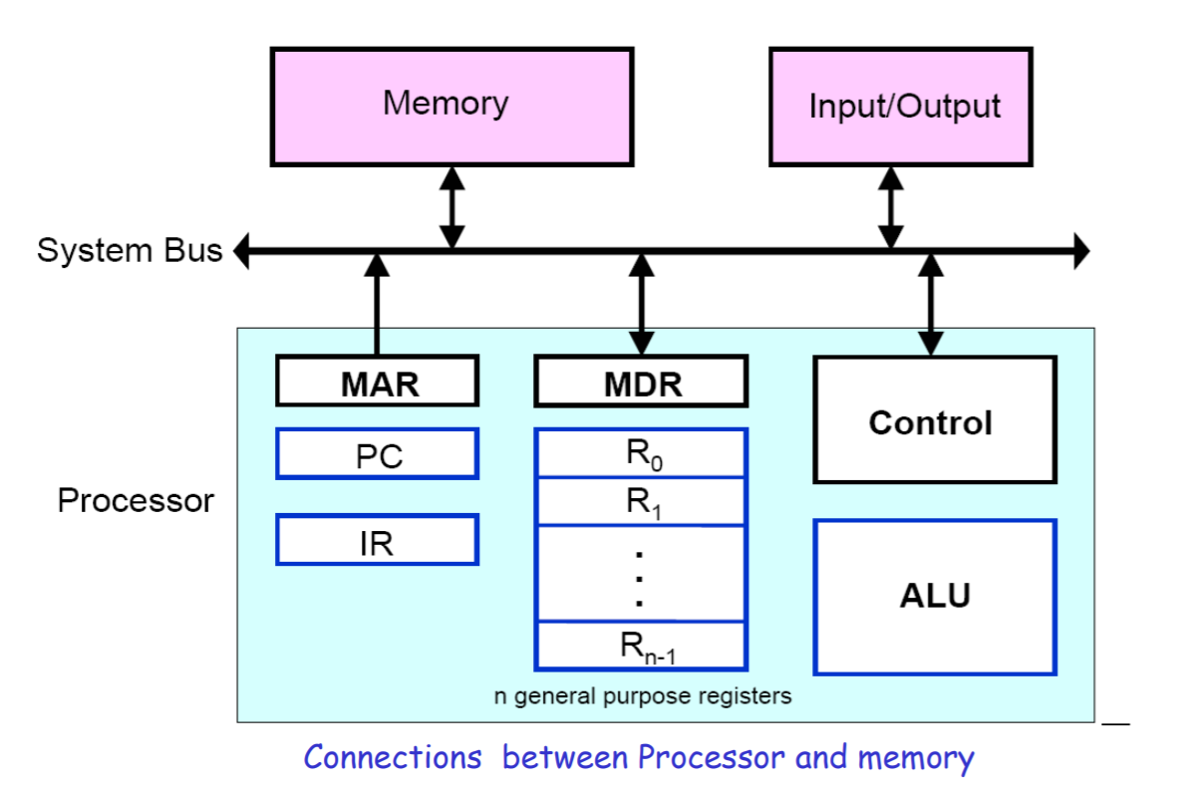

Slide 19
Registers
Registers are fast stand-alone storage locations that hold data temporarily. Multiple registers are needed to facilitate the operation of the CPU. Some of these registers are
Two registers-MAR (Memory Address Register) and MDR (Memory Data Register) : To handle the data transfer between main memory and processor. MAR-Holds addresses, MDR-Holds data
Instruction register (IR) : Hold the Instructions that is currently being executed
Program counter (PC) : Points to the next instructions that is to be fetched from memory
General-purpose Registers: are used for holding data, intermediate results of operations. They are also known as scratch-pad registers.

Slide 20
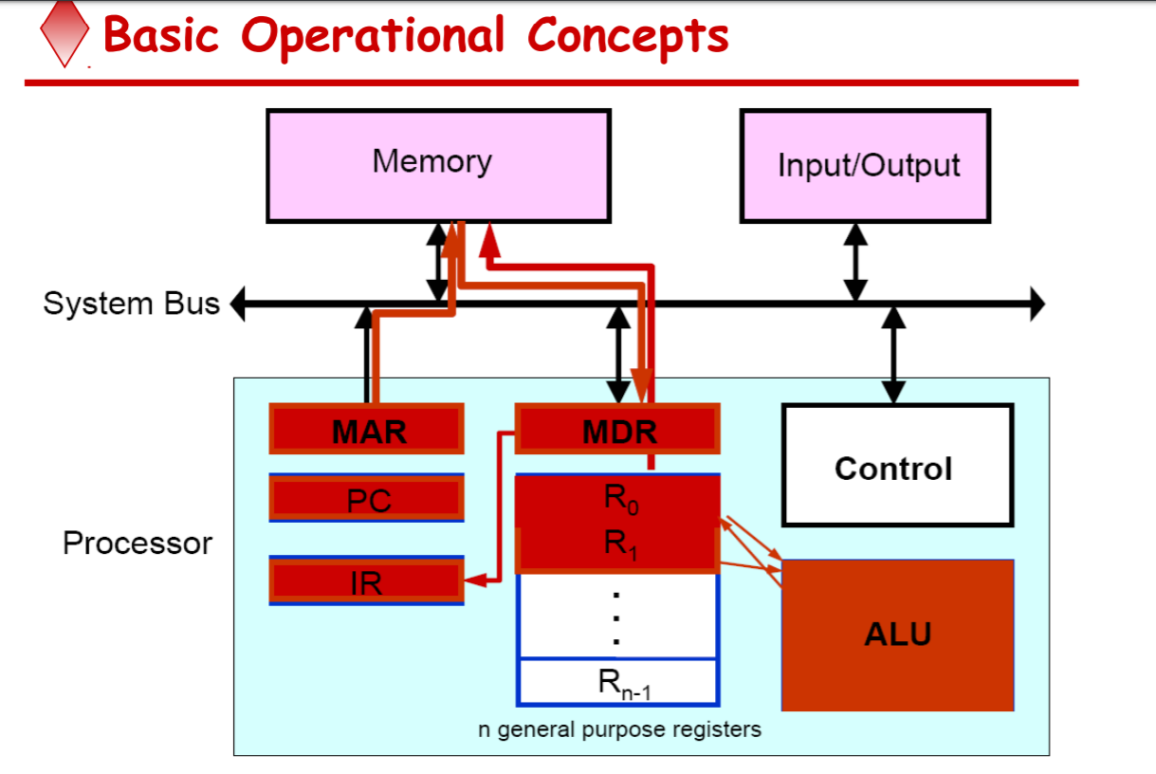

Slide 21
INSTRUCTION FETCH – STEPS INVOLVED
Program gets into the memory through an input device.
Execution of a program starts by setting the PC to point to the first instruction of the program.
The contents of PC are transferred to the MAR and a Read control signal is sent to the memory.
The addressed word (here it is the first instruction of the program) is read out of memory and loaded into the MDR.
The contents of MDR are transferred to the IR for instruction decoding

Slide 22
INSTRUCTION EXECUTION – STEPS IVOLVED
The operation field of the instruction in IR is examined to determine the type of operation to be performed by the ALU.
The specified operation is performed by obtaining the operand(s) from the memory locations or from GP registers.
1) Fetching the operands from the memory requires sending the memory location address to the MAR and initiating a Read cycle.
2) The operand is read from the memory into the MDR and then from MDR to the ALU.

Slide 23
INSTRUCTION EXECUTION – STEPS IVOLVED (Contd..)
3) The ALU performs the desired operation on one or more operands fetched in this manner and sends the result either to memory location or to a GP register.
4) The result is sent to MDR and the address of the location where the result is to be stored is sent to MAR and Write cycle is initiated.
Thus, the execute cycle ends for the current instruction and the PC is incremented to point to the next instruction for a new fetch cycle.

Slide 24
Interrupt
An interrupt is a request from I/O device for service by processor
Processor provides requested service by executing interrupt service routine (ISR)
Contents of PC, general registers, and some control information are stored in memory .
When ISR completed, processor restored, so that interrupted program may continue

Slide 25
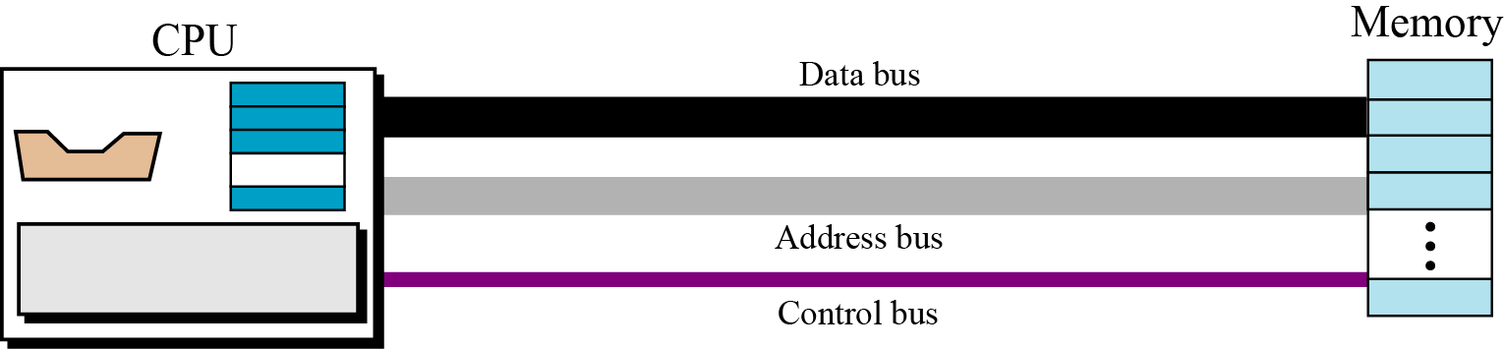
BUS STRUCTURE
Connecting CPU and memory
The CPU and memory are normally connected by three groups of connections, each called a bus: data bus, address bus and control bus
Connecting CPU and memory using three buses

Slide 26
BUS STRUCTURE
Group of wires which carries information from CPU to peripherals or vice – versa
Single bus structure: Common bus used to communicate between peripherals and microprocessor
SINGLE BUS STRUCTURE
INPUT
MEMORY
PROCESSOR
OUTPUT

Slide 27
Drawbacks of the Single Bus Structure
The devices connected to a bus vary widely in their speed of operation.
Some devices are relatively slow, such as printer and keyboard.
Some devices are considerably fast, such as optical disks.
Memory and processor units operate are the fastest parts of a computer.
Efficient transfer mechanism thus is needed to cope with this problem.
A common approach is to include buffer registers with the devices to hold the information during transfers .
An another approach is to use two-bus structure and an additional transfer mechanism

Slide 28
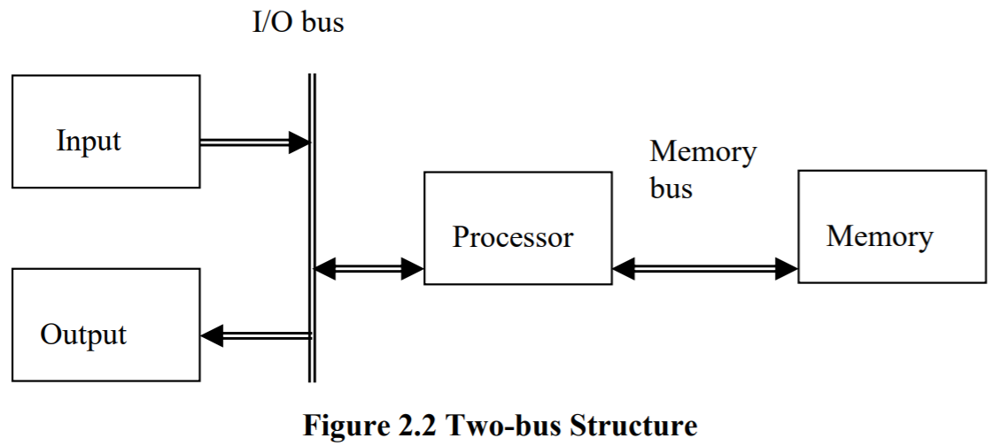
TWO BUS STRUCTURE:
In two – bus structure : One bus can be used to fetch instruction other can be used to fetch data, required for execution. The bus is said to perform two distinct functions The main advantage of this structure is good operating speed but on account of more cost.

Slide 29
MULTI BUS STRUCTURE
To improve performance multi bus structure can be used.
CONTROL BUS
A₂ | A₁ | A₀ | Selected location
0 | 0 | 0 | 0th Location
0 | 0 | 1 | 1st Location
0 | 1 | 0
0 | 1 | 1
1 | 0 | 0
1 | 0 | 1
1 | 1 | 0
1 | 1 | 1
W/R
CS
RD
A0
A1
A2
PROCESSOR
ADDRESS BUS
D7
D0
D0
D7
DATA BUS

Slide 30
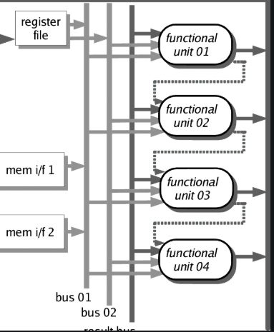
MULTI BUS STRUCTURE To improve performance multi bus structure can be used.

Slide 31
2³ = 8 i.e. 3 address line is required to select 8 location
In general 2^{x} = n where x number of address lines (address bit) and n is number of location
Address bus : unidirectional : group of wires which carries address information bits from processor to peripherals (16,20,24 or more parallel signal lines)
Data bus: bidirectional : group of wires which carries data information bit form processor to peripherals and vice – versa
Control bus: bidirectional: group of wires which carries control signals form processor to peripherals and vice – versa

Slide 32
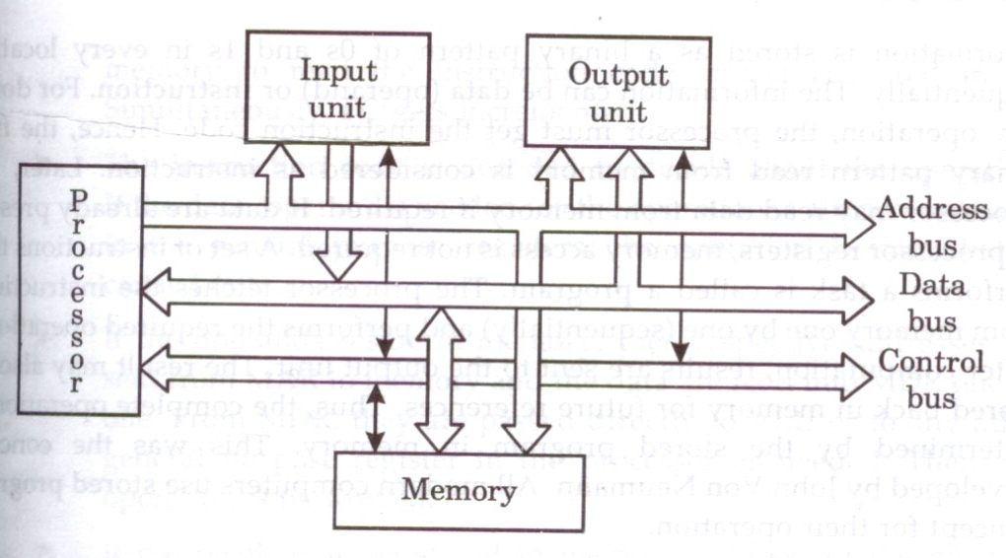
Figure below shows address, data and control bus and their connection with peripheral and microprocessor
Single bus structure showing the details of connection

Slide 33
Memory Locations and Addresses
Notes:
33

Slide 34
Memory Location and Addresses
Memory consists of many millions of storage cells, each of which can store 1 bit.
Data is usually accessed in n-bit groups. n is called word length.
The memory of a computer can be schematically represented as a collection of words as shown in Figure 1.
n
bits
first word
second word
•
•
•
i
th word
•
•
•
last word
Figure 1 Main Memory words.
Notes:
34

Slide 35
MEMORY LOCATIONS AND ADDRESSES
Main memory is the second major subsystem in a computer. It consists of a collection of storage locations, each with a unique identifier, called an address.
Data is transferred to and from memory in groups of bits called words. A word can be a group of 8 bits, 16 bits, 32 bits or 64 bits (and growing).
If the word is 8 bits, it is referred to as a byte. The term “byte” is so common in computer science that sometimes a 16-bit word is referred to as a 2-byte word, or a 32-bit word is referred to as a 4-byte word.

Slide 36
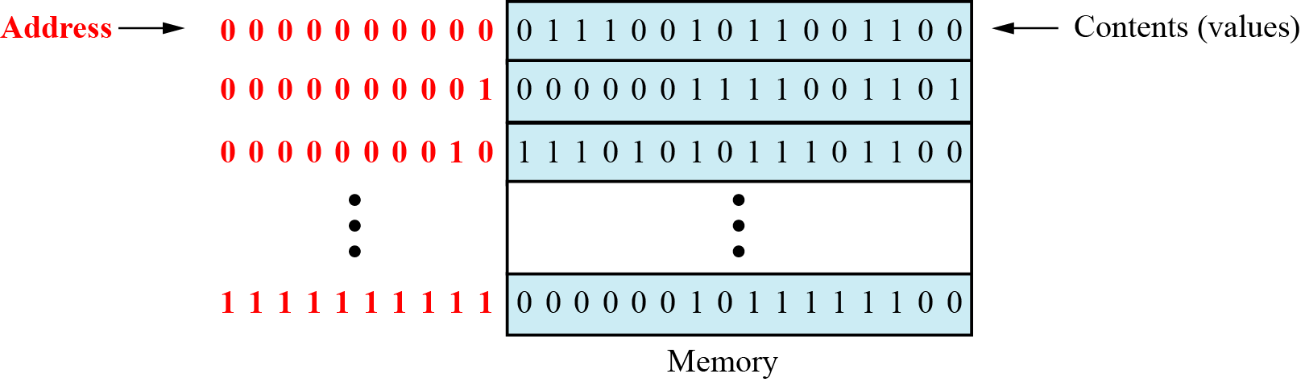
Main memory

Slide 37
Address space
To access a word in memory requires an identifier. Although programmers use a name to identify a word (or a collection of words), at the hardware level each word is identified by an address.
The total number of uniquely identifiable locations in memory is called the address space.
For example, a memory with 64 kilobytes (16 address line required) and a word size of 1 byte has an address space that ranges from 0 to 65,535.

Slide 38
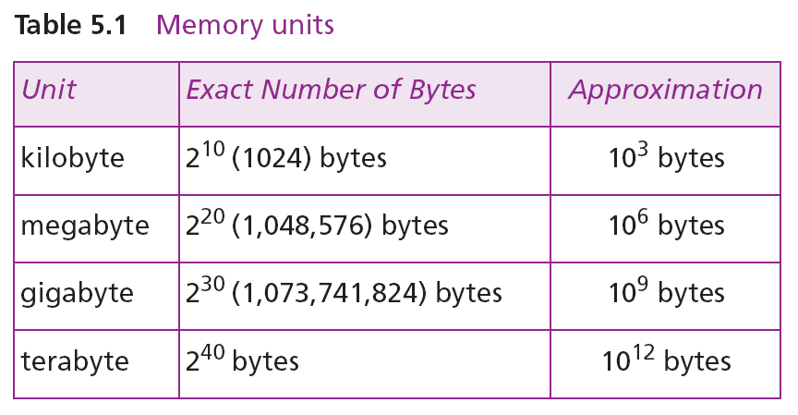
Memory addresses are defined using unsigned binary integers.

Slide 39
Example 1
A computer has 32 MB (megabytes) of memory. How many bits are needed to address any single byte in memory?
Solution
The memory address space is 32 MB, or 2²⁵ (2⁵ × 2²⁰). This means that we need log₂ 2²⁵, or 25 bits, to address each byte.
Example 2
A computer has 128 MB of memory. Each word in this computer is eight bytes. How many bits are needed to address any single word in memory?
Solution
The memory address space is 128 MB, which means 2²⁷. However, each word is eight (2³) bytes, which means that we have 2²⁴ words. This means that we need log₂ 2²⁴, or 24 bits, to address each word.

Slide 40
MEMORY OPERATIONS
Today, general-purpose computers use a set of instructions called a program to process data.
A computer executes the program to create output data from input data
Both program instructions and data operands are stored in memory
Two basic operations requires in memory access
Load operation (Read or Fetch)-Contents of specified memory location are read by processor
Store operation (Write)- Data from the processor is stored in specified memory location

Slide 41
MEMORY ADDRESSING
BYTE ADDRESSABILITY
MEMORY ASSIGNMENT
LITTLE ENDIAN
BIG ENDIAN

Slide 42
n bit
LASTWORD
In theoretical approach each row is called as WORD or LOCATION
But in practice each location contains one byte information, which is referred as byte addressability

Slide 43
BIG ENDIAN AND LITTLE ENDIAN
If the least significant byte of the word occupies the lower address in memory it is called Little endian scheme
Eg: INTEL 8085 INTEL 8086 Processor uses this scheme
If the most significant byte of the word occupies the lower address in memory it is called Big endian scheme
Eg: Motorola and Power PC Processors

Slide 44
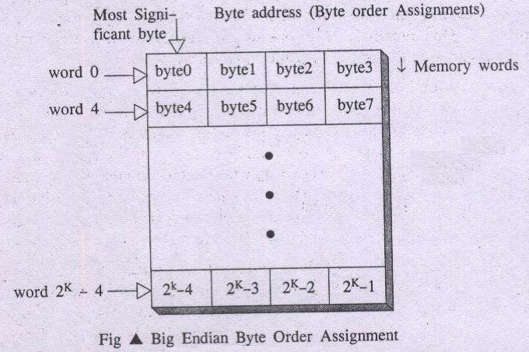
Big endian Assignment

Slide 45
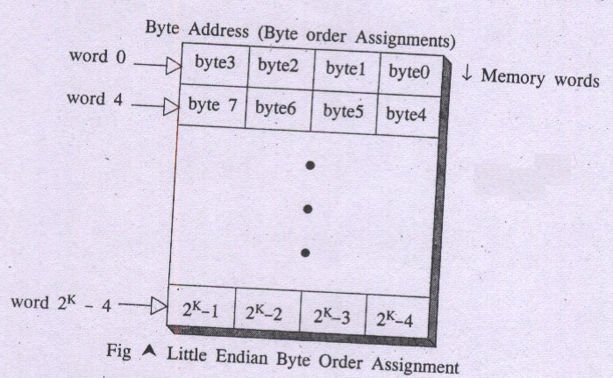
Little – Endian assignment:
In this scheme byte 0 appears as the right most byte of word 0.
Low order bytes represents least significant bytes or right most bytes.

Slide 46
In case of 16 bit data, aligned words begin at byte addresses of 0,2,4,………………………….
In case of 32 bit data, aligned words begin at byte address of 0,4,8,………………………….
In case of 64 bit data, aligned words begin at byte addresses of 0,8,16,………………………..
In some cases words can start at an arbitrary byte address also then, we say that word locations are unaligned

Slide 47
Instruction and instruction sequencing

Slide 48
Instruction
Instruction: is command to the microprocessor to perform a given task on specified data.
Instruction Set: The entire group of these instructions are called instruction set.
instruction sequencing : The order in which the instructions in a program are carried out.

Slide 49
Types of Instructions
Most computer instructions are classified into 3 categories
Data transfer Instructions
To Transfer data from one location to another
Data Manipulation Instructions
To perform the operations by the ALU
Program control Instructions
To control the system

Slide 50
Data transfer Instructions
They are also called copy instructions.
Some instructions in 8086:
MOV -Copy from the source to the destination
LDA - Load the accumulator
STA - Store the accumulator
PUSH - Push the register contents onto the stack
POP - Pop off stack to the register

Slide 51
Data Manipulation Instructions
To perform the operations by the ALU
Three categories:
Arithmetic Instructions
Logical and bit manipulation instructions
Shift instructions

Slide 52
Arithmetic Instructions
Used to perform arithmetic operations
Some instruction in 8086
INC ➔ Increment the data by 1
DEC ➔ Decrement data by 1
ADD ➔ perform sum of data
ADC ➔ Add with carry bit.
MUL ➔ perform multiplication

Slide 53
Logical and bit manipulation instructions
Used to perform logical operations
Some instructions are:
AND ➔ bitwise AND operation
OR ➔ bitwise AND operation
NOT ➔ invert each bit of a byte or word
XOR ➔ Exclusive-OR operation over each bit

Slide 54
Shift instructions
used for shifting or rotating the contents of the register
Some instructions are:
SHR ➔ shift bits towards the right and put zero in MSB
SHL ➔shift bits towards left and put zero in LSB
ROL ➔ rotate bits towards the left, i.e. MSB to LSB and to Carry Flag [CF]
ROR ➔ rotate bits towards the right, i.e. LSB to MSB and CF.

Slide 55
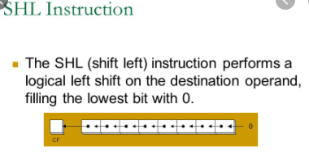
SHL and SHR

Slide 56
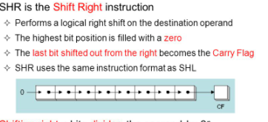

Slide 57
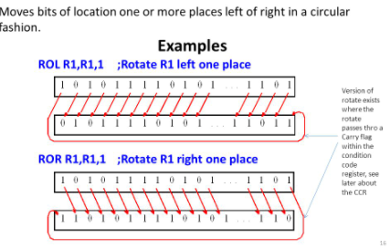

Slide 58
Basic Instruction Formats
Three – Address Instruction
Two – Address Instruction
One – Address Instruction
Zero – Address Instruction
Three – Address Instruction
Suppose we would like to use a single machine instruction to perform the following addition operation:
S ← [P] + [Q]
We will have to use a three – address instruction to carry out addition and to store the sum in a third variable S.
Then three address instruction to perform addition is:
Add P, Q, S

Slide 59
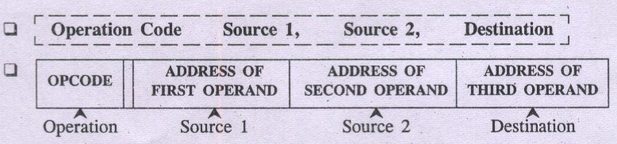
General form of three – address instruction

Slide 60
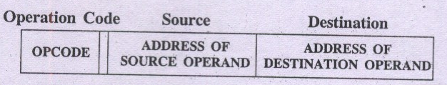
Two – Address Instruction
Two – address instruction general format:
Example of two – address instruction Add P, Q
To perform operation of addition as : Q ← [P] + [Q]
Destination Operand
Source Operand/s

Slide 61
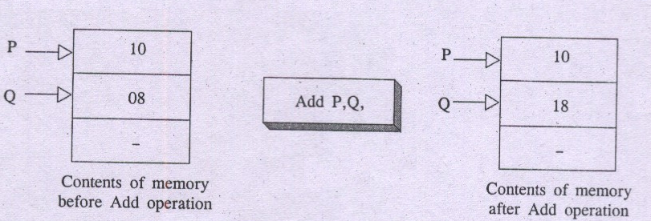
Here one of the operand i.e. destination operand Q acts as source as well as destination.
To perform S ← [P] + [Q]
Use two – address instructions sequence: MOVE S, Q
ADD S,P

Slide 62
One – Address Instruction
One –address instruction format specify a single operand along with operation code.
The requirement of second operand is fulfilled by an implicit processor register known as Accumulator (AC).
Example of one-address instruction: ADD Q
To perform S ← [P] + [Q]
Use one – address instructions : Load P; AC ← [P]
Add Q; AC ← [AC] + [Q]
Store S; S ← [AC]

Slide 63
Zero – Address Instruction
Stack – organized computer make use of a special memory structure called push down stack to store operands. In such computer machines it is possible to use instructions that contain only operation codes and no explicit operands.
The name Zero – address specifies the absence of an address field of operands in machine instructions.
Example of Zero – address instruction: ADD
To perform operation of addition as TOS ← (P + Q)

Slide 64
Instruction Formats
Example: Evaluate (A+B) ∗ (C+D)
Three-Address
ADD A, B,R1 ; R1 ← M[A] + M[B]
ADD C, D,R2 ; R2 ← M[C] + M[D]
MUL R1, R2,X ; M[X] ← R1 ∗ R2

Slide 65
Instruction Formats
Example: Evaluate (A+B) ∗ (C+D)
Two-Address
MOV A,R1 ; R1 ← M[A]
ADD B,R1 ; R1 ← R1 + M[B]
MOV C,R2 ; R2 ← M[C]
ADD D,R2 ; R2 ← R2 + M[D]
MUL R2, R1 ; R1 ← R1 ∗ R2
MOV R1,X ; M[X] ← R1

Slide 66
Instruction Formats
Example: Evaluate (A+B) ∗ (C+D)
One-Address
LOAD A ; AC ← M[A]
ADD B ; AC ← AC + M[B]
STORE T ; M[T] ← AC
LOAD C ; AC ← M[C]
ADD D ; AC ← AC + M[D]
MUL T ; AC ← AC ∗ M[T]
STORE X ; M[X] ← AC

Slide 67
Instruction Formats
Example: Evaluate (A+B) ∗ (C+D)
Zero-Address
PUSH A ; TOS ← A
PUSH B ; TOS ← B
ADD ; TOS ← (A + B)
PUSH C ; TOS ← C
PUSH D ; TOS ← D
ADD ; TOS ← (C + D)
MUL ; TOS ← (C+D)∗(A+B)
POP X ; M[X] ← TOS

Slide 68
Instruction Cycle
the basic operational process of a computer.
also known as fetch-decode-execute cycle
This process is repeated continuously by CPU from boot up to shut down of computer.
steps that occur during an instruction cycle:
1. Fetch the Instruction
2. Decode the Instruction 3. Read the Effective Address
4. Execute the Instruction

Slide 69
1. Fetch the Instruction
The instruction is fetched from memory address that is stored in PC(Program Counter) and stored in the (instruction register) IR.
At the end of the fetch operation, PC is incremented by 1 and it then points to the next instruction to be executed.
2. Decode the Instruction
The instruction in the IR is decoded(Interpreted).

Slide 70
3. Read the Effective Address
If the instruction has an indirect address, the effective address is read from the memory. Otherwise operands are directly read in case of immediate operand instruction.
4. Execute the Instruction
The Control Unit passes the information in the form of control signals to the functional unit of CPU. The result generated is stored in main memory or sent to an output device.
The cycle is then repeated by fetching the next instruction. Thus in this way the instruction cycle is repeated continuously.

Slide 71
start
Load address to PC
Load content of PC to IR
Update PC to next address
Execute Instruction
Interrupts
Service Interrupt

Slide 72
Addressing Modes
Different ways in which the location of the operand is specified in an instruction is referred as addressing modes
The purpose of using addressing mode is:
To give the programming versatility to the user.
To reduce the number of bits in addressing field of instruction.
Types of Addressing Modes
Immediate Addressing
Direct Addressing
Indirect Addressing
Register Addressing
Register Indirect Addressing
Relative Addressing
Indexed Addressing
Auto Increment
Auto Decrement

Slide 73
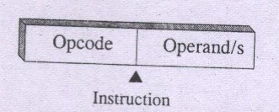
Immediate Addressing mode
Here the operand is specified in the instruction itself. An instruction that follows immediate mode has an operand field rather than an address field.
R2
R1
For example:
Move 50_{immediate}, R0
A common convention say, a sharp sign # has to precede the value of an immediate operand
Move #50, R0
50
R0

Slide 74
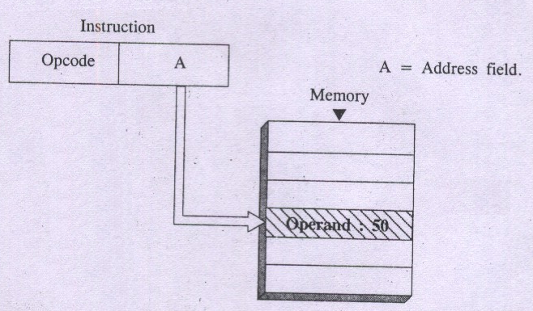
Direct Addressing Mode /Absolute Mode
Here operand resides in Memory and its address is given explicitly in the address field of an instruction. This scheme need only one memory reference in addition to instruction fetch cycle and no further calculation is required to compute operand address.
Direct addressing scheme is simple to use. However it offers only limited memory address space.

Slide 75
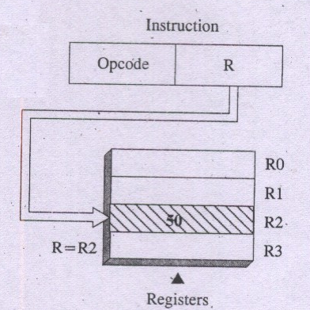
Register Addressing Mode
In this scheme, name of the register (address code of a specific general purpose register) appears in the address field of an instruction i.e. A = R

Slide 76
Register Addressing Mode
Advantages of this scheme :
No memory reference
A few bit address to indicate register location
Speedy execution since register is inside the processor
& has low access time.
Disadvantages of this scheme :
Limited address space as number of registers are less
in many of the processors.

Slide 77
Indirect Addressing Mode
Here, the address field of an instruction gives the address of
a memory word in which effective address or actual address
of the operand is found.
By referring to this address (EA), the required operand
can be fetched from memory.
Example: Add (A), R0 i.e. EA = (A) i.e. contents of A is B
Here B is effective address of desired operand in memory

Slide 78
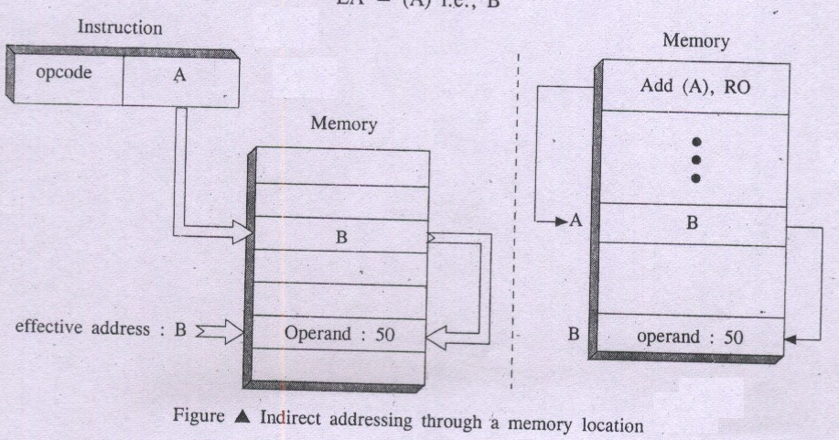
Indirect Addressing Mode

Slide 79
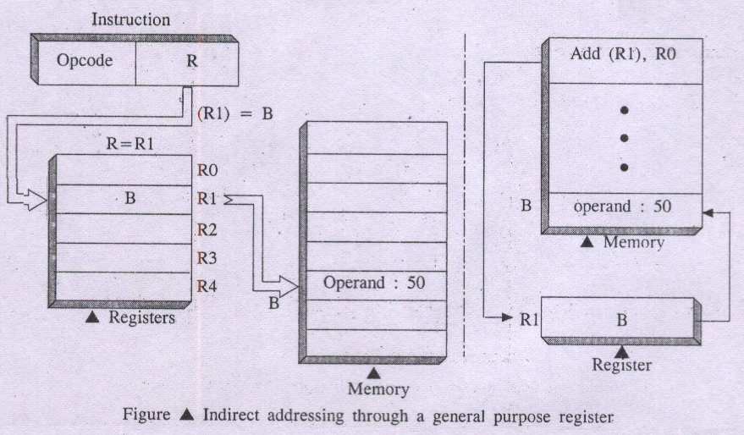
Register Indirect Addressing Mode
Here, instruction specifies a register in the CPU whose contents give the effective address of the operand in Memory.
For example Add (R1), R0 i.e. EA = (R1) i.e. contents of R1 is B

Slide 80
The advantage of Register Indirect Addressing:
It uses one less memory reference (memory read operation)
Address field of the instruction uses a fewer bits to
specify a register

Slide 81
Indexed Addressing Mode
Here, effective address of the operand is generated
by adding a constant value to the contents of a register.
This constant value may be either an offset value called
displacement or beginning address of data/operand array
in main memory (Base).
Indexed addressing mode is symbolically represented as
X(R)
Here X denote a constant and R is name of the register
involved in Indexing.
Effective address EA of the operand is given as
EA = X + [R]
Contents of index register are not changed during the
process of address generation.

Slide 82
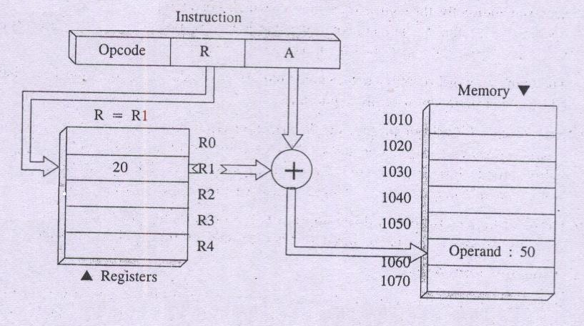
Indexed Addressing Mode
A = 1040 = X; constant X corresponds to a memory location
(R) = 20 i.e. Index or offset value
EA = A + (R) = 1040 + 20
EA = 1060 at which you will find desired operand 50

Slide 83
Relative Addressing Mode
This scheme supplies the relative position of the memory
operand to be located.
It’s like index mode only but program counter register PC
substitutes for base address contents
Relative Mode specify Effective Address by a notation:
X(PC)
Effective address is EA = [ PC ] + X

Slide 84
Auto Increment Mode
Here contents of a register specified in the instruction are
incremented to denote effective address of next operand in
successive memory location.
After accessing the operand, the contents of this register are
incremented again automatically to point to the next operand
in contiguous memory locations.
Notation for Auto Increment Mode: (R_{i}) +
For example: Add (R2) +, R0
Use of Auto Increment mode instruction eliminates the use of
explicit increment instruction

Slide 85
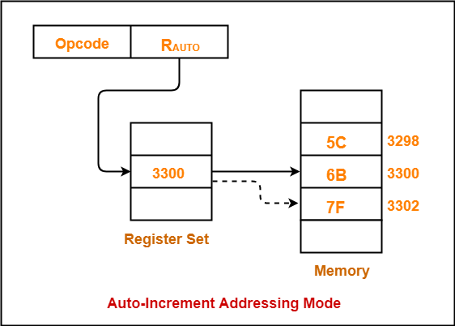

Slide 86
Auto Decrement Mode
Here, content of a register specified in the instruction is
decremented to denote effective address of next operand in
successive memory location.
Notation for Auto Decrement Mode: - (R_{i})
For instance
Add – (R2), R0
It allows accessing of operands in decreasing order of
memory address..

Slide 87
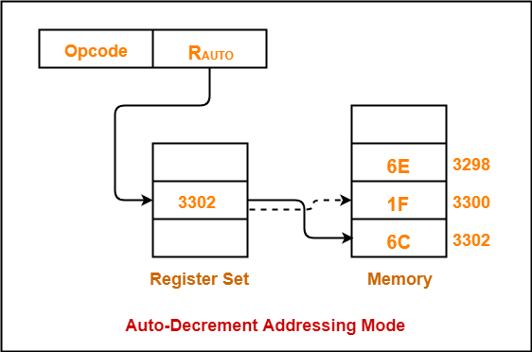

Slide 88
Definition of the Microprocessor
Microprocessor: It is a semiconductor device consisting of electronic logic circuits. It includes the ALU, register arrays and control circuits on a single chip.
The microprocessor has a set of instructions, designed internally, to manipulate data and communicate with peripherals.
The microprocessor is a programmable device that takes in numbers, performs on them arithmetic or logical operations according to the program stored in memory and then produces other numbers as a result.

Slide 89
Microprocessor
It only understands binary numbers.
A binary digit is called a bit (which comes from binary digit).
The microprocessor recognizes and processes a group of bits together. This group of bits is called a “word”.
A group of 8-bits were referred to as a “half-word” or “byte”.
A group of 4 bits is called a “nibble”.
Also, 32 bit groups were given the name “long word”.
Today, all processors manipulate at least 32 bits at a time and there exists microprocessors that can process 64, 80, 128 bits

Slide 90
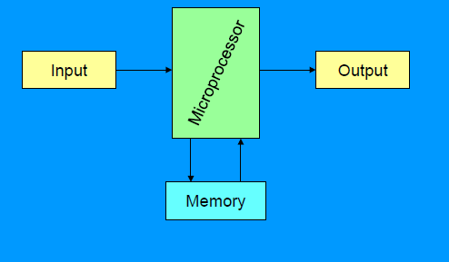
A Microprocessor-based system

Slide 91
Microprocessor
Inside The Microprocessor
Internally, the microprocessor is made up of 3 main units. The Arithmetic/Logic Unit (ALU)
The Control Unit.
An array of registers for holding data while it is being manipulated.

Slide 92
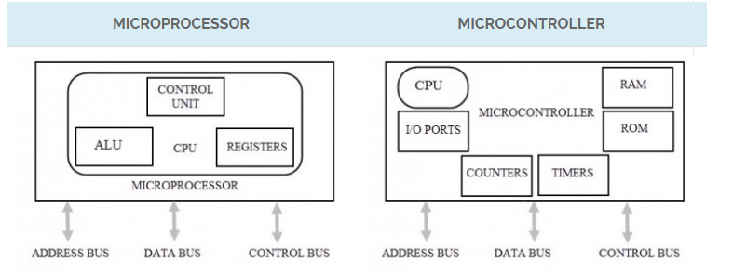
The differences between microprocessors and microcontrollers.

Slide 93
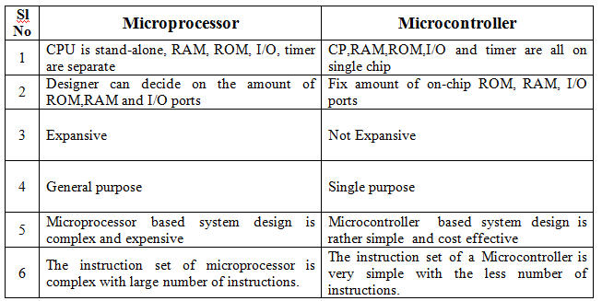

Slide 94
Internal structure and basic operation of microprocessor
ALU
Register Section
Address bus
Data bus
Control and timing section
Control bus
Block diagram of a Microprocessor

Slide 95
Microprocessor performs three main tasks:
data transfer between itself and the memory or I/O systems
simple arithmetic and logic operations
program flow via simple decisions

Slide 96
Microprocessor types
Microprocessors can be characterized based on
the word size
8 bit, 16 bit, 32 bit, etc. processors
Instruction set structure
RISC (Reduced Instruction Set Computer), CISC (Complex Instruction Set Computer)
Functions
General purpose, special purpose such image processing, floating point calculations
And more …

Slide 97
Evolution of Microprocessors
The first microprocessor was introduced in 1971 by Intel Corp.
It was named Intel 4004 as it was a 4 bit processor.
Categories according to the generations or size
First Generation (4 - bit Microprocessors)
could perform simple arithmetic such as addition, subtraction, and logical operations like Boolean OR and Boolean AND.
had a control unit capable of performing control functions like
fetching an instruction from storage memory,
decoding it, and then
generating control pulses to execute it.

Slide 98
Second Generation (8 - bit Microprocessor)
The second generation microprocessors were introduced in 1973 again by Intel.
the first 8 - bit microprocessor which could perform arithmetic and logic operations on 8-bit words.
Third Generation (16 - bit Microprocessor)
introduced in 1978
represented by Intel's 8086, Zilog Z800 and 80286,
16 - bit processors with a performance like minicomputers.

Slide 99
Fourth Generation (32 - bit Microprocessors)
Several different companies introduced the 32-bit microprocessors
the most popular one is the Intel 80386
Fifth Generation (64 - bit Microprocessors)
Introduced in 1995
After 80856, Intel came out with a new processor namely Pentium processor followed by Pentium Pro CPU
allows multiple CPUs in a single system to achieve multiprocessing.
Other improved 64-bit processors are Celeron, Dual, Quad, Octa Core processors.

Slide 100
Typical microprocessors
Most commonly used
68K
Motorola
x86
Intel
IA-64
Intel
MIPS
Microprocessor without interlocked pipeline stages
ARM
Advanced RISC Machine
PowerPC
Apple-IBM-Motorola alliance
Atmel AVR
A brief summary will be given later

Slide 101
8086 Microprocessor
designed by Intel in 1976
16-bit Microprocessor having
20 address lines
16 data lines
provides up to 1MB storage
consists of powerful instruction set, which provides operations like multiplication and division easily.
supports two modes of operation
Maximum mode :
suitable for system having multiple processors
Minimum mode :
suitable for system having a single processor.

Slide 102
Features of 8086
Has an instruction queue, which is capable of storing six instruction bytes
First 16-bit processor having
16-bit ALU
16-bit registers
internal data bus
16-bit external data bus

Slide 103
uses two stages of pipelining
1. Fetch Stage and
2. Execute Stage
Fetch stage : can pre-fetch up to 6 bytes of instructions and stores them in the queue.
Execute stage : executes these instructions.

Slide 104
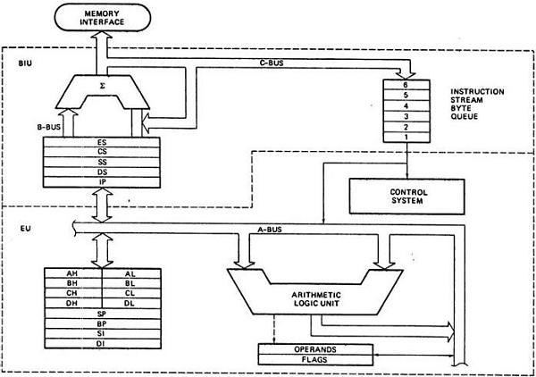
Architecture of 8086

Slide 105
Segments in 8086
memory is divided into various sections called segments
Code segment : where you store the program.
Data segment : where the data is stored.
Extra segment : mostly used for string operations.
Stack segment : used to push/pop

Slide 106
General purpose registers
used to store temporary data within the microprocessor
AX – Accumulator
16 bit register
divided into two 8-bit registers AH and AL to
perform 8-bit instructions also
generally used for arithmetical and logical
instructions
BX – Base register
16 bit register
divided into two 8-bit registers BH and BL to
perform 8-bit instructions also
Used to store the value of the offset.

Slide 107
CX – Counter register
16 bit register
divided into two 8-bit registers CH and CL to
perform 8-bit instructions also Used in looping and rotation
DX – Data register
16 bit register
divided into two 8-bit registers DH and DL to
perform 8-bit instructions also Used in multiplication an input/output port addressing

Slide 108
Pointers and Index Registers
SP – Stack pointer
16 bit register
points to the topmost item of the stack
If the stack is empty the stack pointer will be (FFFE)H
It’s offset address relative to stack segment
BP –Base pointer
16 bit register
used in accessing parameters passed by the stack
It’s offset address relative to stack segment

Slide 109
SI – Source index register
16 bit register
used in the pointer addressing of data and
as a source in some string related operations
It’s offset is relative to data segment
DI – Destination index register
16 bit register used in the pointer addressing of data and
as a destination in string related operations
It’s offset is relative to extra segment.

Slide 110
IP - Instruction Pointer
16 bit register
stores the address of the next instruction
to be executed
also acts as an offset for CS register.

Slide 111
Segment Registers
CS - Code Segment Register: user cannot modify the content of these registers
Only the microprocessor's compiler can do this
DS - Data Segment Register: The user can modify the content of the data segment.
SS - Stack Segment Registers: used to store the information about the memory segment.
operations of the SS are mainly Push and Pop.
ES - Extra Segment Register: By default, the control of the compiler remains in the DS where the user can add and modify the instructions
If there is less space in that segment, then ES is used
Also used for copying purpose.

Slide 112
Flag or Status Register
16-bit register
contains 9 flags
remaining 7 bits are idle in this register
These flags tell about the status of the processor after any arithmetic or logical operation
IF the flag value is 1, the flag is set, and if it is 0, it is said to be reset.

Slide 113
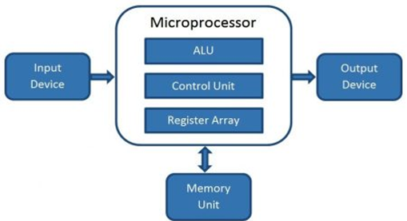
Microcomputer
Block Diagram
A digital computer with one microprocessor which acts as a CPU
A complete computer on a small scale, designed for use by one person at a time
called a personal computer (PC)
a device based on a single-chip microprocessor
includes laptops and desktops

Slide 114
Introduction to 8086 Assembly Language
Assembly Language Programming

Slide 115
Program Statements
Program consist of statement, one per line.
Each statement is either an instruction, which the assembler translate into machine code, or assembler directive, which instructs the assembler to perform some specific task, such as allocating memory space for a variable or creating a procedure.
Both instructions and directives have up to four fields:
At least one blank or tab character must separate the fields
name operation operand(s) comment

Slide 116
Program Statements
An example of an instruction is
START: MOV CX,5 ; initialize counter
The name field consists of the label START:
The operation is MOV, the operands are CX and 5
And the comment is ; initialize counter
name operation operand(s) comment
An example of an assembler directive is
MAIN PROC
MAIN is the name, and the operation field contains PROC
This particular directive creates a procedure called MAIN
name operation operand(s) comment

Slide 117
Program Statements
name operation operand(s) comment
A Name field identifies a label, variable, or symbol.
It may contain any of the following character : A,B…..Z ; a,b….z ; 0,1….9 ; ? ;
_ (underline) ; @ ; $ ; . (period)
Only the first 31 characters are recognized
There is no distinction between uppercase and lower case letters.
The first character may not be a digit
If it is used, the period ( . ) may be used only as the first character.
A programmer-chosen name may not be the same as an assembler reserved word.

Slide 118
Program Statements
name operation operand(s) comment
Operation field is a predefined or reserved word
mnemonic - symbolic operation code.
The assembler translates a symbolic opcode into a machine language opcode.
Opcode symbols often describe the operation’s function; for example, MOV, ADD, SUB
assemler directive - pseudo-operation code.
In an assembler directive, the operation field contains a pseudo-operation code (pseudo-op)
Pseudo-op are not translated into machine code; for example the PROC pseudo-op is used to create a procedure

Slide 119
Program Statements
name operation operand(s) comment
An operand field specifies the data that are to be acted on by the operation.
An instruction may have zero, one, or two operands. For example:
NOP No operands; does nothing
INC AX one operand; adds 1 to the
contents of AX
ADD WORD1,2 two operands; adds 2 to the contents of memory

Slide 120
Program Statements
name operation operand(s) comment
The comment field is used by the programmer to say something about what the statement does.
A semicolon marks the beginning of this field, and the assembler ignores anything typed after semicolon.
Comments are optional, but because assembly language is low level, it is almost impossible to understand an assembly language program without comments.

Slide 121
Program Data and Storage
Pseudo-ops to define data or reserve storage
DB - byte(s)
DW - word(s)
DD - doubleword(s)
DQ - quadword(s)
DT - tenbyte(s)
These directives require one or more operands
define memory contents
specify amount of storage to reserve for run-time data

Slide 122
Defining Data
Numeric data values
100 - decimal
100B - binary
100H - hexadecimal
'100' - ASCII
"100" - ASCII
Use the appropriate DEFINE directive (byte, word, etc.)
A list of values may be used - the following creates 4 consecutive words
DW 40CH,10B,-13,0
A ? represents an uninitialized storage location
DB 255,?,-128,'X'

Slide 123
Naming Storage Locations
Names can be associated with storage locations
ANum DB -4
DW 17
ONE UNO DW 1
X DD ?
These names are called variables
ANum refers to a byte storage location, initialized to 4
The next word has no associated name
ONE and UNO refer to the same word
X is an unitialized doubleword

Slide 124
• Multiple definitions can be abbreviated
Example:
message DB ’B’
DB ’y’
DB ’e’
DB 0DH
DB 0AH
can be written as
message DB ’B’,’y’,’e’,0DH,0AH
• More compactly as
message DB ’Bye’,0DH,0AH

Slide 125
Arrays
Any consecutive storage locations of the same size can be called an array
X DW 40CH,10B,-13,0
Y DB 'This is an array'
Z DD -109236, FFFFFFFFH, -1, 100B
Components of X are at X, X+2, X+4, X+6
Components of Y are at Y, Y+1, …, Y+15
Components of Z are at Z, Z+4, Z+8, Z+12

Slide 126
DUP
Allows a sequence of storage locations to be defined or reserved
Only used as an operand of a define directive
DB 40 DUP (?) ; 40 bytes, uninitialized
DW 10h DUP (0) ; 10 words, initialized as 0
Table1 DW 10 DUP (?) ; 10 words, uninitialized
message DB 3 DUP (’Baby’) ; 12 bytes, initialized
; as BabyBabyBaby
Name1 DB 30 DUP (’?’) ; 30 bytes, each
; initialized to ?

Slide 127
DUP
The DUP directive may also be nested
Example
stars DB 4 DUP(3 DUP (’*’),2 DUP (’?’),5 DUP (’!’))
Reserves 40-bytes space and initializes it as
***??!!!!!***??!!!!!***??!!!!!***??!!!!!
matrix DW 10 DUP (5 DUP (0))
defines a 10X5 matrix and initializes its elements to zero.
This declaration can also be done by
matrix DW 50 DUP (0)

Slide 128
Word Storage
Word, doubleword, and quadword data are stored in reverse byte order (in memory)
Directive Bytes in Storage
DW 256 56 02
DD 1234567H 67 45 23 01
DQ 10 0A 00 00 00 00 00 00 00
X DW 35DAh DA 35
Low byte of X is at X, high byte of X is at X+1

Slide 129
Word Storage

Slide 130
Named Constants
Symbolic names associated with storage locations represent addresses
Named constants are symbols created to represent specific values determined by an expression
Named constants can be numeric or string
Some named constants can be redefined
No storage is allocated for these values

Slide 131
Equal Sign Directive
name = expression
expression must be numeric
these symbols may be redefined at any time
maxint = 7FFFh
count = 1
DW count
count = count * 2
DW count

Slide 132
EQU Directive
name EQU expression
expression can be string or numeric
Use < and > to specify a string EQU
these symbols cannot be redefined later in the program
sample EQU 7Fh
aString EQU <1.234>
message EQU <This is a message>

Slide 133
Data Transfer Instructions
MOV target, source
reg, reg
mem, reg
reg, mem
mem, immed
reg, immed
Sizes of both operands must be the same
reg can be any non-segment register except IP cannot be the target register
MOV's between a segment register and memory or a 16-bit register are possible

Slide 134
Sample MOV Instructions
b db 4Fh
w dw 2048
mov bl,dh
mov ax,w
mov ch,b
mov al,255
mov w,-100
mov b,0
When a variable is created with a define directive, it is assigned a default size attribute (byte, word, etc)
You can assign a size attribute using LABEL
LoByte LABEL BYTE

Slide 135
Program Segment Structure
Data Segments
Storage for variables
Variable addresses are computed as offsets from start of this segment
Code Segment
contains executable instructions
Stack Segment
used to set aside storage for the stack
Stack addresses are computed as offsets into this segment
Segment directives
.data
.code
.stack size

Slide 136
Instruction types Data transfer instructions
8086 instruction set
IN Input byte or word from port
LAHF Load AH from flags
LDS Load data segment from specified reg
LEA Load effective address in to AX reg
LES Load extra segment from specified the reg
MOV Move to/from register/memory
OUT Output byte or word to port
POP Pop off word from the stack
POPF Pop off word from the stack to the flag
PUSH Push word onto stack
PUSHF Push contents of flags onto stack
SAHF Store AH into flags
XCHG Exchange byte or word
XLAT Translate byte

Slide 137
Arithmetic instructions
8086 instruction set
AAA ASCII adjust for addition
AAD ASCII adjust for division
AAM ASCII adjust for multiply
AAS ASCII adjust for subtraction
ADC Add byte or word plus carry
ADD Add byte or word
CBW Convert byte to word
CMP Compare byte or word
CWD Convert word to double-word
DAA Decimal adjust for addition
DAS Decimal adjust for subtraction
DEC Decrement byte or word by one
DIV Divide byte or word
IDIV Integer divide byte or word
IMUL Integer multiply byte or word
INC Increment byte or word by one
MUL Multiply byte or word (unsigned)
NEG Negate byte or word
SBB Subtract byte or word and carry (borrow)
SUB Subtract byte or word
Additional 80386 instructions
CDQ Convert double-word to quad-word
CWDE Convert word to double-word
Additional 80486 instructions
CMPXCHG Compare and exchange
XADD Exchange and add
Additional Pentium instruction
CMPXCHG8B Compare and exchange 8 bytes

Slide 138
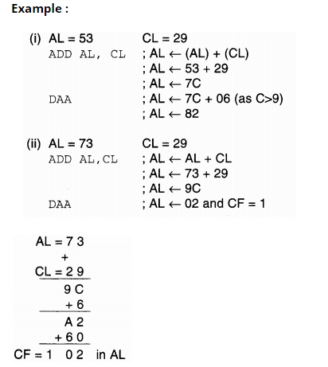
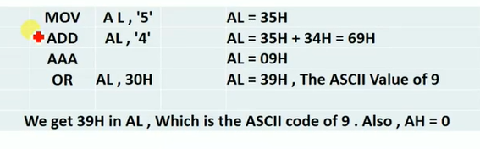
AAA and DAA

Slide 139
Bit manipulation instructions
8086 instruction set
AND Logical AND of byte or word
NOT Logical NOT of byte or word
OR Logical OR of byte or word
RCL Rotate left trough carry byte or word
RCR Rotate right trough carry byte or word
ROL Rotate left byte or word
ROR Rotate right byte or word
SAL Arithmetic shift left byte or word
SAR Arithmetic shift right byte or word
SHL Logical shift left byte or word
SHR Logical shift right byte or word
TEST Test byte or word
XOR Logical exclusive-OR of byte or word

Slide 140
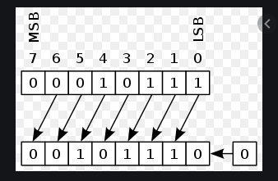
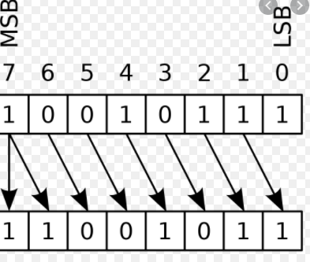
SAR and SAL

Slide 141
String instructions
8086 instruction set
CMPS Compare byte or word string
LODS Load byte or word string into al/ax
MOVS Move byte or word string
MOVSB(MOVSW) Move byte string (word string)
REP Repeat
REPE (REPZ) Repeat while equal (zero)
REPNE (REPNZ) Repeat while not equal (not zero)
SCAS Scan byte or word string
STOS Store byte or word string in to register

Slide 142
Program Skeleton
.model small
.stack 100H
.data
;declarations
.code
main proc
;code
main endp
;other procs
end main
Select a memory model
Define the stack size
Declare variables
Write code
organize into procedures
Mark the end of the source file
optionally, define the entry point

Slide 143
EXAMPLE : Adding two 8 bit numbers
DATA SEGMENT ; Data Segment
N1 DB 12H
N2 DB 21H
RES DB ?
DATA ENDS
CODE SEGMENT ; Code segment
ASSUME CS: CODE, DS: DATA
START: MOV AX, DATA
MOV DS, AX
MOV AL, N1
MOV BL, N2
ADD AL, BL
MOV RES, AL
INT 21H
CODE ENDS
END START

Slide 144
Basics of Input - Output Operations

Slide 145
Input - Output Interface
Input Output Interface provides a method for transferring information between internal storage and external I/O devices. Peripherals connected to a computer need special communication links for interfacing them with the central processing unit.

Slide 146
Input - Output Interface
The purpose of communication link is to resolve the differences that exist between the central computer and each peripheral.

Slide 147
The Major Differences are:-
Peripherals are electro-mechanical and electromagnetic devices and their manner of operation of the CPU and memory, which are electronic devices. Therefore, a conversion of signal values may be needed.
The data transfer rate of peripherals is usually slower than the transfer rate of CPU and consequently, a synchronization mechanism may be needed.

Slide 148
The Major Differences are:-
Data codes and formats in the peripherals differ from the word format in the CPU and memory.
The operating modes of peripherals are different from each other and must be controlled so as not to disturb the operation of other peripherals connected to the CPU.

Slide 149
Input - Output Interface
To Resolve these differences, computer systems include special hardware components between the CPU and Peripherals to supervises and synchronizes all input and out transfers. These components are called Interface Units because they interface between the processor bus and the peripheral devices.

Slide 150
I/O BUS and Interface Module
It defines the typical link between the processor and several peripherals. The I/O Bus consists of data lines, address lines and control lines.
The I/O bus from the processor is attached to all peripherals interface. To communicate with a particular device, the processor places a device address on address lines.

Slide 151
I/O BUS and Interface Module
Each Interface decodes the address and control received from the I/O bus, interprets them for peripherals and provides signals for the peripheral controller.
It is also synchronizes the data flow and supervises the transfer between peripheral and processor. Each peripheral has its own controller. For example, the printer controller controls the paper motion, the print timing.

Slide 152
I/O BUS and Interface Module
The control lines are referred as an I/O command. The commands are as following:
Control command- A control command is issued to activate the peripheral and to inform it what to do.
Status command- A status command is used to test various status conditions in the interface and the peripheral.

Slide 153
I/O BUS and Interface Module
Output data command-
A data output command causes the interface to respond by transferring data from the bus into one of its registers.
Input data command-
The data input command is the opposite of the data output. In this case the interface receives on item of data from the peripheral and places it in its buffer register.

Slide 154
I/O BUS and Interface Module
Data
Processor
Address
Control
Interface
Interface
Interface
Keyboard and display terminal
Printer
Magnetic disk
Connection of I/O bus to input-output devices

Slide 155
I/O Versus Memory Bus
To communicate with I/O, the processor must communicate with the memory unit. Like the I/O bus, the memory bus contains data, address and read/write control lines. There are 3 ways that computer buses can be used to communicate with memory and I/O:
i. Use two Separate buses , one for memory and other for I/O.
ii. Use one common bus for both memory and I/O but separate control lines for each.
iii. Use one common bus for memory and I/O with common control lines.

Slide 156
The ARM Architecture

Slide 157

ARM Ltd
Founded in November 1990
An ARM processor is one of a family of CPUs based on the RISC (reduced instruction set computer) architecture developed by Advanced RISC Machines (ARM)
Designs the ARM range of RISC processor cores
Notes:
The ARM processor core originates within a British computer company called Acorn. In the mid-1980s they were looking for replacement for the 6502 processor used in their BBC computer range, which were widely used in UK schools. None of the 16-bit architectures becoming available at that time met their requirements, so they designed their own 32-bit processor.
Other companies became interested in this processor, including Apple who were looking for a processor for their PDA project (which became the Newton). After much discussion this led to Acorn’s processor design team splitting off from Acorn at the end of 1990 to become Advanced RISC Machines Ltd, now just ARM Ltd.
Thus ARM Ltd now designs the ARM family of RISC processor cores, together with a range of other supporting technologies.
One important point about ARM is that it does not fabricate silicon itself, but instead just produces the design - we are an Intellectual Property (or IP) company. Instead silicon is produced by companies who license the ARM processor design.

Slide 158

ARM Partnership Model
Notes:
ARM’s business model centres around the principle of partnership. At the centre of this are ARM’s semiconductor partners who design, manufacture and market ARM-compliant products.
Having so many partner companies producing silicon executing the same instruction set is a very important part of ARM’s strength in the market place.
However each of our semiconductor partners bring their own unique strengths to the partnership - each having their own technologies, applications knowledge, product focus, culture, geography, and key customers.
In addition to our partnering with semiconductor companies, we also partner with a large number of other third parties to ensure that operating systems, EDA and software development tools, application software and design services are available for doing ARM based designs.
“ATAP” stands for ARM Technology Access Program. Creates a network of independent design service companies and equips them to deliver ARM-powered designs. Members get access to ARM technology, expertise and support. Members sometimes referred to as “Approved Design Centers”.

Slide 159

ARM Powered Products

Slide 160
Data Sizes and Instruction Sets
The ARM is a 32-bit architecture.
When used in relation to the ARM:
Byte means 8 bits
Halfword means 16 bits (two bytes)
Word means 32 bits (four bytes)
Most ARM’s implement two instruction sets
32-bit ARM Instruction Set
16-bit Thumb Instruction Set
Jazelle cores can also execute Java bytecode
Notes:
The cause of confusion here is the term “word” which will mean 16-bits to people with a 16-bit background.
In the ARM world 16-bits is a “halfword” as the architecture is a 32-bit one, whereas “word” means 32-bits.
Java bytecodes are 8-bit instructions designed to be architecture independent. Jazelle transparently executes most bytecodes in hardware and some in highly optimized ARM code. This is due to a tradeoff between hardware complexity (power consumption & silicon area) and speed.

Slide 161
Processor Modes
The ARM has seven basic operating modes:
User : unprivileged mode under which most tasks run
FIQ : entered when a high priority (fast) interrupt is raised
IRQ : entered when a low priority (normal) interrupt is raised
Supervisor : entered on reset and when a Software Interrupt
instruction is executed
Abort : used to handle memory access violations
Undef : used to handle undefined instructions
System : privileged mode using the same registers as user mode
Notes:
The Programmers Model can be split into two elements - first of all, the processor modes and secondly, the processor registers. So let’s start by looking at the modes.
Now the typical application will run in an unprivileged mode know as “User” mode, whereas the various exception types will be dealt with in one of the privileged modes : Fast Interrupt, Supervisor, Abort, Normal Interrupt and Undefined (and we will look at what causes each of the exceptions later on).
NB - spell out the word FIQ, otherwise you are saying something rude in German!
One question here is what is the difference between the privileged and unprivileged modes? Well in reality very little really - the ARM core has an output signal (nTRANS on ARM7TDMI, InTRANS, DnTRANS on 9, or encoded as part of HPROT or BPROT in AMBA) which indicates whether the current mode is privileged or unprivileged, and this can be used, for instance, by a memory controller to only allow IO access in a privileged mode. In addition some operations are only permitted in a privileged mode, such as directly changing the mode and enabling of interrupts.
All current ARM cores implement system mode (added in architecture v4). This is simply a privileged version of user mode. Important for re-entrant exceptions because no exceptions can cause system mode to be entered.

Slide 162
The Registers
ARM has 37 registers all of which are 32-bits long.
1 dedicated program counter
1 dedicated current program status register
5 dedicated saved program status registers
30 general purpose registers
The current processor mode governs which of several banks is accessible. Each mode can access
a particular set of r0-r12 registers
a particular r13 (the stack pointer, sp) and r14 (the link register, lr)
the program counter, r15 (pc)
the current program status register, cpsr
Privileged modes (except System) can also access
a particular spsr (saved program status register)
Notes:
The ARM architecture provides a total of 37 registers, all of which are 32-bits long. However these are arranged into several banks, with the accessible bank being governed by the current processor mode. We will see this in more detail in a couple of slides. In summary though, in each mode, the core can access:
a particular set of 13 general purpose registers (r0 - r12).
a particular r13 - which is typically used as a stack pointer. This will be a different r13 for each mode, so allowing each exception type to have its own stack.
a particular r14 - which is used as a link (or return address) register. Again this will be a different r14 for each mode.
r15 - whose only use is as the Program counter.
The CPSR (Current Program Status Register) - this stores additional information about the state of the processor:
And finally in privileged modes, a particular SPSR (Saved Program Status Register). This stores a copy of the previous CPSR value when an exception occurs. This combined with the link register allows exceptions to return without corrupting processor state.

Slide 163
Register Organization Summary
User
FIQ
IRQ
SVC
Undef
Abort
r0
User mode r0-r7, r15, and cpsr
User mode r0-r12, r15, and cpsr
User mode r0-r12, r15, and cpsr
User mode r0-r12, r15, and cpsr
User mode r0-r12, r15, and cpsr
r1
r2
r3
r4
Thumb state
Low registers
r5
r6
r7
r8
r8
r9
r9
r10
r10
Thumb state
High registers
r11
r11
r12
r12
r13 (sp)
r13 (sp)
r13 (sp)
r13 (sp)
r13 (sp)
r13 (sp)
r14 (lr)
r14 (lr)
r14 (lr)
r14 (lr)
r14 (lr)
r14 (lr)
r15 (pc)
cpsr
spsr
spsr
spsr
spsr
spsr
Note: System mode uses the User mode register set
Notes:
This slide shows the registers visible in each mode - basically in a more static fashion than the previous animated slide that is more useful for reference.
The main point to state here is the splitting of the registers in Thumb state into Low and High registers.
ARM register banking is the minimum necessary for fast handling of overlapping exceptions of different types (e.g. ABORT during SWI during IRQ). For nested exceptions of the same type (e.g. re-entrant interrupts) some additional pushing of registers to the stack is required.

Slide 164
The ARM Register Set
Current Visible Registers
Current Visible Registers
Current Visible Registers
Current Visible Registers
Current Visible Registers
r0
r0
r0
r0
r0
SVC Mode
r0
Undef Mode
FIQ Mode
User Mode
IRQ Mode
r1
r1
r1
r1
r1
r1
Abort Mode
r0
r2
r2
r2
r2
r2
r2
Banked out Registers
Banked out Registers
Banked out Registers
Banked out Registers
r1
Banked out Registers
r3
r3
r3
r3
r3
r3
r2
r4
r4
r4
r4
r4
r4
Banked out Registers
r3
r5
r5
r5
r5
r5
r5
r4
User
User
User
User
FIQ
FIQ
FIQ
FIQ
FIQ
IRQ
IRQ
IRQ
IRQ
IRQ
SVC
SVC
SVC
SVC
SVC
Undef
Undef
Undef
Undef
Undef
Abort
Abort
Abort
Abort
Abort
r6
Abort
r6
r6
r6
r6
r6
r5
r7
r7
r7
r7
r7
r7
User
FIQ
IRQ
SVC
Undef
r6
r8
r8
r8
r8
r8
r8
r8
r8
r8
r8
r8
r7
r8
r9
r9
r9
r9
r9
r9
r9
r9
r9
r9
r9
r8
r9
r10
r8
r10
r10
r10
r10
r10
r10
r10
r10
r10
r10
r9
r10
r11
r9
r11
r11
r11
r11
r11
r11
r11
r11
r11
r11
r10
r11
r12
r10
r12
r12
r12
r12
r12
r12
r12
r12
r12
r12
r11
r12
r13 (sp)
r11
r13 (sp)
r13 (sp)
r13 (sp)
r13 (sp)
r13 (sp)
r13 (sp)
r13 (sp)
r13 (sp)
r13 (sp)
r13 (sp)
r13 (sp)
r13 (sp)
r13 (sp)
r13 (sp)
r13 (sp)
r13 (sp)
r13 (sp)
r13 (sp)
r13 (sp)
r13 (sp)
r13 (sp)
r13 (sp)
r13 (sp)
r13 (sp)
r13 (sp)
r13 (sp)
r13 (sp)
r13 (sp)
r13 (sp)
r13 (sp)
r13 (sp)
r13 (sp)
r13 (sp)
r13 (sp)
r12
r12
r13 (sp)
r14 (lr)
r14 (lr)
r14 (lr)
r14 (lr)
r14 (lr)
r14 (lr)
r14 (lr)
r14 (lr)
r14 (lr)
r14 (lr)
r14 (lr)
r14 (lr)
r14 (lr)
r14 (lr)
r14 (lr)
r14 (lr)
r14 (lr)
r14 (lr)
r14 (lr)
r14 (lr)
r14 (lr)
r14 (lr)
r14 (lr)
r14 (lr)
r14 (lr)
r14 (lr)
r14 (lr)
r14 (lr)
r14 (lr)
r14 (lr)
r14 (lr)
r14 (lr)
r14 (lr)
r14 (lr)
r14 (lr)
r13 (sp)
r13 (sp)
r13 (sp)
r13 (sp)
r13 (sp)
r13 (sp)
r14 (lr)
r15 (pc)
r15 (pc)
r15 (pc)
r15 (pc)
r15 (pc)
r15 (pc)
r14 (lr)
r14 (lr)
r14 (lr)
r14 (lr)
r14 (lr)
r14 (lr)
r15 (pc)
cpsr
cpsr
cpsr
cpsr
cpsr
cpsr
spsr
spsr
spsr
spsr
spsr
spsr
spsr
spsr
spsr
spsr
spsr
spsr
spsr
spsr
spsr
spsr
spsr
spsr
spsr
spsr
spsr
spsr
spsr
spsr
spsr
spsr
spsr
spsr
spsr
cpsr
spsr
spsr
spsr
spsr
spsr
spsr
Notes:
This animated slide shows the way that the banking of registers works. On the left the currently visible set of registers are shown for a particular mode.
On the right are the registers that are banked out whilst in that mode.
Each key press will switch mode:
user -> FIQ ->user -> IRQ -> user ->SVC -> User -> Undef -> User -> Abort and then back to user.
The following slide then shows this in a more static way that is more useful for reference

Slide 165
Program Status Registers
31
28
27
24
23
16
15
8
7
6
5
4
0
N Z C V Q
U n d e f i n e d
I F T mode
J
f
s
x
c
Condition code flags
N = Negative result from ALU
Z = Zero result from ALU
C = ALU operation Carried out
V = ALU operation oVerflowed
Sticky Overflow flag - Q flag
Architecture 5TE/J only
Indicates if saturation has occurred
J bit
Architecture 5TEJ only
J = 1: Processor in Jazelle state
Interrupt Disable bits.
I = 1: Disables the IRQ.
F = 1: Disables the FIQ.
T Bit
Architecture xT only
T = 0: Processor in ARM state
T = 1: Processor in Thumb state
Mode bits
Specify the processor mode
Notes:
Green psr bits are only in certain versions of the ARM architecture
ALU status flags (set if "S" bit set, implied in Thumb state).
Sticky overflow flag (Q flag) is set either when
saturation occurs during QADD, QDADD, QSUB or QDSUB, or
the result of SMLAxy or SMLAWx overflows 32-bits
Once flag has been set can not be modified by one of the above instructions and must write to CPSR using MSR instruction to cleared
PSRs split into four 8-bit fields that can be individually written:
Control (c) bits 0-7
Extension (x) bits 8-15 Reserved for future use
Status (s) bits 16-23 Reserved for future use
Flags (f) bits 24-31
Bits that are reserved for future use should not be modified by current software. Typically, a read-modify-write strategy should be used to update the value of a status register to ensure future compatibility. Note that the T/J bits in the CPSR should never be changed directly by writing to the PSR (use the BX/BXJ instruction to change state instead).
However, in cases where the processor state is known in advance (e.g. on reset, following an interrupt, or some other exception), an immediate value may be written directly into the status registers, to change only specific bits (e.g. to change mode).
New ARM V6 bits now shown.

Slide 166
Program Counter (r15)
When the processor is executing in ARM state:
All instructions are 32 bits wide
All instructions must be word aligned
Therefore the pc value is stored in bits [31:2] with bits [1:0] undefined (as instruction cannot be halfword or byte aligned).
When the processor is executing in Thumb state:
All instructions are 16 bits wide
All instructions must be halfword aligned
Therefore the pc value is stored in bits [31:1] with bit [0] undefined (as instruction cannot be byte aligned).
When the processor is executing in Jazelle state:
All instructions are 8 bits wide
Processor performs a word access to read 4 instructions at once
Notes:
ARM is designed to efficiently access memory using a single memory access cycle. So word accesses must be on a word address boundary, halfword accesses must be on a halfword address boundary. This includes instruction fetches.
Point out that strictly, the bottom bits of the PC simply do not exist within the ARM core - hence they are ‘undefined’. Memory system must ignore these for instruction fetches.
In Jazelle state, the processor doesn’t perform 8-bit fetches from memory. Instead it does aligned 32-bit fetches (4-byte prefetching) which is more efficient. Note we don’t mention the PC in Jazelle state because the ‘Jazelle PC’ is actually stored in r14 - this is technical detail that is not relevant as it is completely hidden by the Jazelle support code.

Slide 167
Exception Handling
When an exception occurs, the ARM:
Copies CPSR into SPSR_<mode>
Sets appropriate CPSR bits
Change to ARM state
Change to exception mode
Disable interrupts (if appropriate)
Stores the return address in
LR_<mode>
Sets PC to vector address
To return, exception handler needs to:
Restore CPSR from SPSR_<mode>
Restore PC from LR_<mode>
This can only be done in ARM state.
0x1C
FIQ
0x18
IRQ
0x14
(Reserved)
0x10
Data Abort
0x0C
Prefetch Abort
0x08
Software Interrupt
0x04
Undefined Instruction
0x00
Reset
Vector Table
Vector table can be at 0xFFFF0000 on ARM720T and on ARM9/10 family devices
Notes:
Exception handling on the ARM is controlled through the use of an area of memory called the vector table. This lives (normally) at the bottom of the memory map from 0x0 to 0x1c. Within this table one word is allocated to each of the various exception types.
This word will contain some form of ARM instruction that should perform a branch. It does not contain an address.
Reset - executed on power on
Undef - when an invalid instruction reaches the execute stage of the pipeline
SWI - when a software interrupt instruction is executed
Prefetch - when an instruction is fetched from memory that is invalid for some reason, if it reaches the execute stage then this exception is taken
Data - if a load/store instruction tries to access an invalid memory location, then this exception is taken
IRQ - normal interrupt
FIQ - fast interrupt
When one of these exceptions is taken, the ARM goes through a low-overhead sequence of actions in order to invoke the appropriate exception handler. The current instruction is always allowed to complete (except in case of Reset).
IRQ is disabled on entry to all exceptions; FIQ is also disabled on entry to Reset and FIQ.

Slide 168
Conditional Execution and Flags
ARM instructions can be made to execute conditionally by postfixing them with the appropriate condition code field.
This improves code density and performance by reducing the number of forward branch instructions.
CMP r3,#0 CMP r3,#0 BEQ skip ADDNE r0,r1,r2 ADD r0,r1,r2 skip
By default, data processing instructions do not affect the condition code flags but the flags can be optionally set by using “S”. CMP does not need “S”.
loop … SUBS r1,r1,#1 BNE loop
decrement r1 and set flags
if Z flag clear then branch
Notes:
Unusual but powerful feature of the ARM instruction set. Other architectures normally only have conditional branches.
Some recently-added ARM instructions (in v5T and v5TE) are not conditional (e.g. v5T BLX offset)
Core compares condition field in instruction against NZCV flags to determine if instruction should be executed.

Slide 169
Condition Codes
The possible condition codes are listed below:
Note AL is the default and does not need to be specified
Suffix
Description
Flags tested
EQ
Equal
Z=1
NE
Not equal
Z=0
CS/HS
Unsigned higher or same
C=1
CC/LO
Unsigned lower
C=0
MI
Minus
N=1
PL
Positive or Zero
N=0
VS
Overflow
V=1
VC
No overflow
V=0
HI
Unsigned higher
C=1 & Z=0
LS
Unsigned lower or same
C=0 or Z=1
GE
Greater or equal
N=V
LT
Less than
N!=V
GT
Greater than
Z=0 & N=V
LE
Less than or equal
Z=1 or N=!V
AL
Always
Notes:
Condition codes are simply a way of testing the ALU status flags.

Slide 170
Examples of conditional execution
Use a sequence of several conditional instructions
if (a==0) func(1);
CMP r0,#0 MOVEQ r0,#1 BLEQ func
Set the flags, then use various condition codes
if (a==0) x=0; if (a>0) x=1;
CMP r0,#0 MOVEQ r1,#0 MOVGT r1,#1
Use conditional compare instructions
if (a==4 || a==10) x=0;
CMP r0,#4 CMPNE r0,#10 MOVEQ r1,#0
Notes:
Sequence of conditional instructions:
- no instruction must reset cond code flags
- BL corrupts flags so must be last
- limit sequence to max 3 or so instrs
Can use different condition codes. Give if then else example. Note GCD practical coming later.
Conditional compare
- resets condition code when executed
- compiler will make use of this
- can be difficult for a human to understand!
Not just for compare, using data processing with condition code and S bit is useful in some circumstances.
LDM/LDR instruction cannot set flags due to datapath issues (data comes back only at the very end of the cycle, so there is no opportunity to perform a comparison and set the status flags).

Slide 171
Branch instructions
Branch : B{<cond>} label
Branch with Link : BL{<cond>} subroutine_label
Branch with link (BL) copies the address of the next instruction (after the BL) into the link register. The branch instruction doesn't. BL would be used for a subroutine call.
31
28
27
25
24
23
0
Cond 1 0 1 L Offset
Link bit 0 = Branch
1 = Branch with link
Condition field
Notes:
PC-relative to allow position independent code, and allows restricted branch range to jump to nearby addresses.
How to access full 32-bit address space? Can set up LR manually if needed, then load into PC
MOV lr, pc
LDR pc, =dest
ADS linker will automatically generate long branch veneers for branches beyond 32Mb range.

Slide 172
Data processing Instructions
Consist of :
Arithmetic: ADD ADC SUB SBC RSB RSC
Logical: AND ORR EOR BIC
Comparisons: CMP CMN TST TEQ
Data movement: MOV MVN
The BIC (Bit Clear) instruction performs an AND operation on the bits in Rn with the complements of the corresponding bits in the value of Operand2
The TST instruction performs a bitwise AND operation on the value in Rn and the value of Operand2
The TEQ instruction performs a bitwise Exclusive OR operation on the value in Rn and the value of Operand2
The MVN instruction takes the value of Operand2 , performs a bitwise logical NOT operation on the value, and places the result into Rd
These instructions only work on registers, NOT memory.
Second operand is sent to the ALU via barrel shifter.
Notes:
BIC bit clear
ORR bit set
AND bit mask
EOR bit invert
Comparisons produce no results - just set condition codes.
CMP like SUB
CMN like ADD (subtract of a negative number is the same as add)
TST like AND
TEQ like EOR (eor of identical numbers gives result of zero)
Generally single-cycle execution (except write to PC and register-controlled shift). Mention ARM NOP & Thumb NOP.
Explain RSB and RSC which do subtract in other order (e.g. y-x not x-y)
Does not include multiply (separate instr format). No divide - compiler uses run-time library or barrel shifter to perform division.
Can combine “S” bit with conditional execution, e.g.
ADDEQS r0, r1, r2

Slide 173
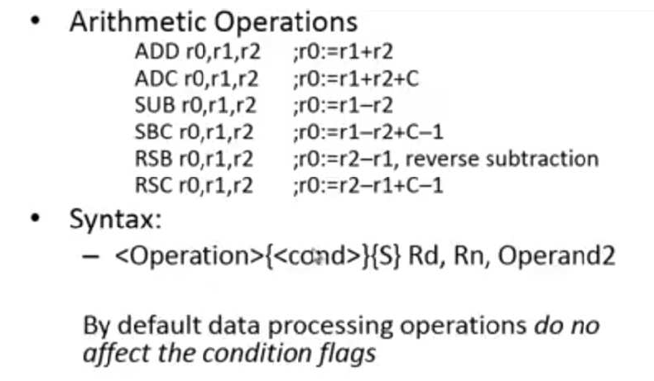
EXAMPLE

Slide 174
Barrel Shifter & Memory Instructions

Slide 175
The Barrel Shifter
LSL : Logical Left Shift
ASR: Arithmetic Right Shift
CF
Destination
0
Destination
CF
Multiplication by a power of 2
Division by a power of 2, preserving the sign bit
LSR : Logical Shift Right
ROR: Rotate Right
...0
Destination
CF
Destination
CF
Division by a power of 2
Bit rotate with wrap around from LSB to MSB
RRX: Rotate Right Extended
Destination
CF
Single bit rotate with wrap around from CF to MSB
Notes:
Rotate left can be implemented as rotate right (32-number), e.g. rotate left of 10 is performed using rotate right of 22.
RRX shifts by 1 bit position, of a 33 bit amount (includes carry flag). Very specialized application (e.g. encryption algorithms). Cannot be generated by C compiler. We have used it for 64/64 bit divide. RRX allows you to shift multiprecision values right by one efficiently. Also used in ARM’s MPEG code in a very tricky piece of code.
ANSI C does not have a rotate operation (it only has “<<“ and “>>” which are the equivalent of LSL, LSR and ASR). However the ARM compiler recognizes rotate type expresssions and optimizes these to use ROR, e.g.
int f(unsigned int a)
{
return (a << 10) | (a >>22) ;
}
=> MOV a1,a1,ROR #22
Carry flag set out of the shifter for *logical* data processing operations

Slide 176
Using the Barrel Shifter: The Second Operand
Operand 1
Operand 2
Register, optionally with shift operation
Shift value can be either be:
5 bit unsigned integer
Specified in bottom byte of another register.
Used for multiplication by constant
Immediate value
8 bit number, with a range of 0-255.
Rotated right through even number of positions
Allows increased range of 32-bit constants to be loaded directly into registers
Barrel Shifter
ALU
Result
Notes:
Mention A bus and B bus on 7TDMI core.
Give examples:
ADD r0, r1, r2
ADD r0, r1, r2, LSL#7
ADD r0, r1, r2, LSL r3
ADD r0, r1, #0x4E

Slide 177
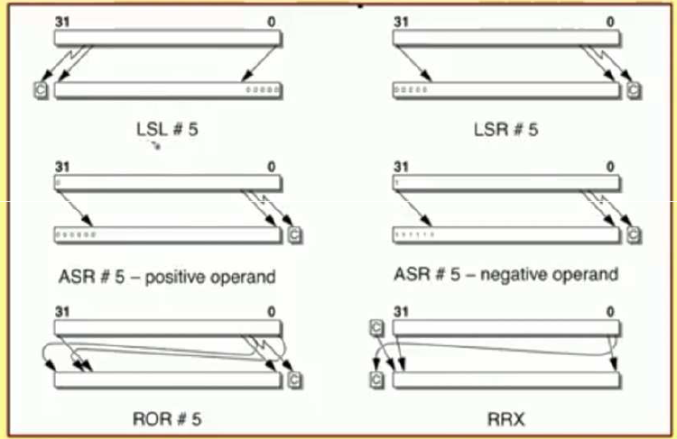
EXAMPLE

Slide 178
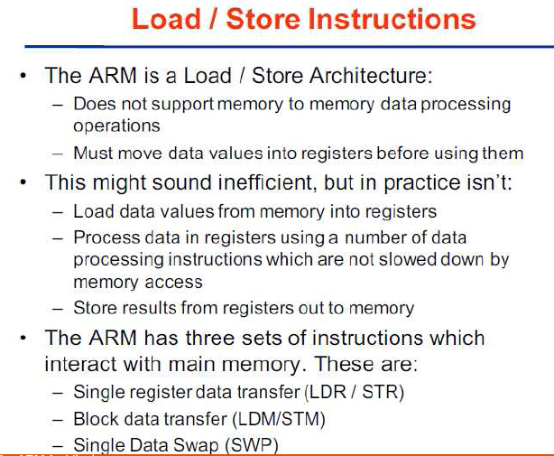

Slide 179
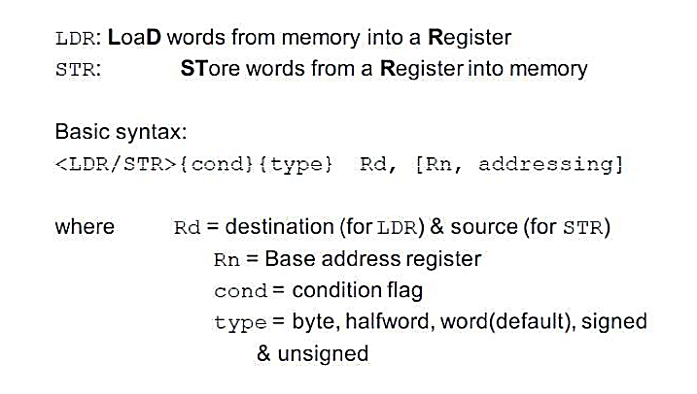
Single register data transfer
Notes:
Point out destination (reg) first for LDR, but destination (mem) last for STR. Different to Motorola, but it keeps the instruction mnemonic format consistent. Always have register loaded/stored first, then address accessed second
Size specifier comes out on MAS (memory access size) signal. Important that memory supports full range of accesses - especially important for writes where only the specified size should be written.
Special types of sign extended load - this is needed because ARM registers only hold 32-bit values. Draw diagram. No need for special store instructions though.
Instruction cycle timing:
STR LDR
7TDMI 2 cycles 3 cycles
9TDMI 1 cycle 1 cycle - interlock if used in next cycle
StrongARM1 1 cycle 1 cycle - interlock if used in next cycle
Xscale 1 cycle 1 cycle - interlock if used in next 2 cycles
Note size specifier comes after condition code.
Link: <address> explained on next slide.
Note that load/store instructions never set condition codes.

Slide 180
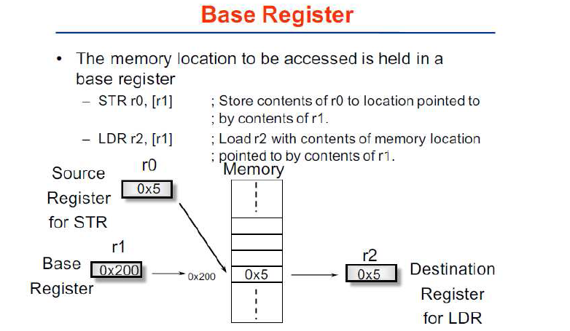

Slide 181
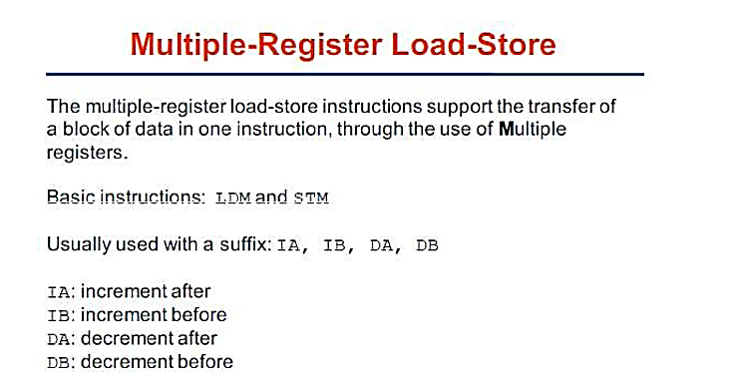
(LDM/STM)

Slide 182
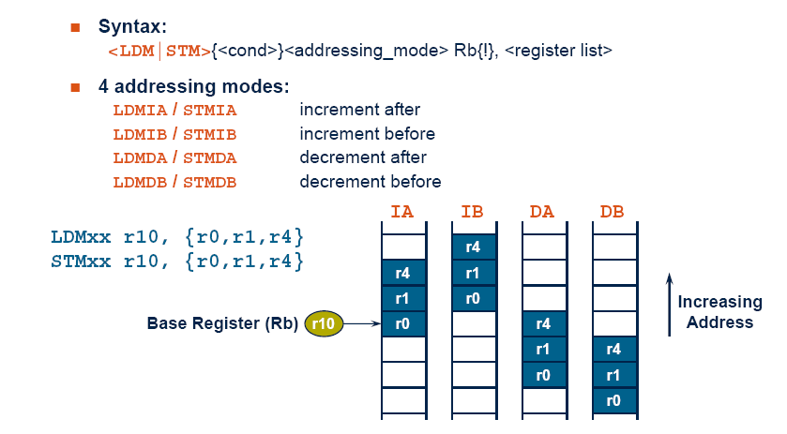
(LDM/STM) OPERATIONS

Slide 183
Software Interrupt (SWI)
31
28
27
24
23
0
Cond 1 1 1 1
SWI number (ignored by processor)
Condition Field
Causes an exception trap to the SWI hardware vector
The SWI handler can examine the SWI number to decide what operation has been requested.
By using the SWI mechanism, an operating system can implement a set of privileged operations which applications running in user mode can request.
Syntax:
SWI{<cond>} <SWI number>
Notes:
In effect, a SWI is a user-defined instruction.
Used for calling the operating system (switches to privileged mode).
SWI number field can be used to specify the operation code, e.g. SWI 1 start a new task, SWI 2 allocate memory, etc. Using a number has the advantage that the O.S. can have different revisions, and the same application code will work on each O.S. rev.

Slide 184
Thumb
Thumb is a 16-bit instruction set
Optimized for code density from C code (~65% of ARM code size)
Improved performance from narrow memory
Subset of the functionality of the ARM instruction set
Core has additional execution state - Thumb
Switch between ARM and Thumb using BX instruction
31
ADDS r2,r2,#1
0
32-bit ARM Instruction
For most instructions generated by compiler:
Conditional execution is not used
Source and destination registers identical
Only Low registers used
Constants are of limited size
Inline barrel shifter not used
15
ADD r2,#1
0
16-bit Thumb Instruction
Notes:
The Thumb instruction set was designed by looking at the instructions produced by the ARM C compiler from real application code to see which instructions were most often used. This subset of instructions was then compressed into 16-bit opcodes to give better code density and better performance from narrow memory
A Thumb compatible processor is still a 32-bit processor, but it has the ability to execute either sections of ARM code or sections of Thumb code. The two instruction sets cannot be interleaved though, a special form of branch has to be used to change “state”.
The diagram then shows the way that a typical 32-bit ARM instruction might be “compressed” into a 16-bit Thumb one.

Slide 185
Example ARM-based System
32 bit RAM
Peripherals
16 bit RAM
Interrupt
Controller
I/O
nIRQ
nFIQ
ARM
Core
8 bit ROM
Notes:
This slides shows a very generic ARM based design, that is actually fairly representative of the designs that we see being done.
On-chip there will be an ARM core (obviously) together with a number of system dependant peripherals. Also required will be some form of interrupt controller which receives interrupts from the peripherals and raised the IRQ or FIQ input to the ARM as appropriate. This interrupt controller may also provide hardware assistance for prioritizing interrupts.
As far as memory is concerned there is likely to be some (cheap) narrow off-chip ROM (or flash) used to boot the system from. There is also likely to be some 16-bit wide RAM used to store most of the runtime data and perhaps some code copied out of the flash. Then on-chip there may well be some 32-bit memory used to store the interrupt handlers and perhaps stacks.

